Slide 1
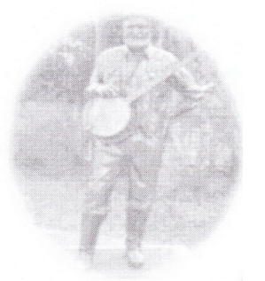
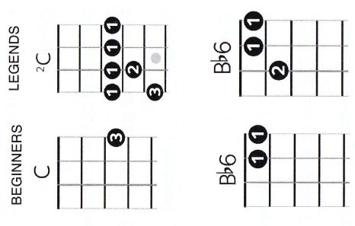

Slide 2
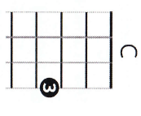
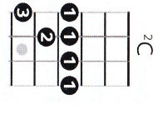
Beginners
Legends

Slide 3
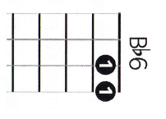
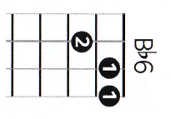
Beginners
Legends

Slide 4
Beginners
Legends

Slide 5
Strumming Pattern
1
2
1
2

Slide 6
Instrument/Chorus

Slide 7
Verses

Slide 8
Chord Sequences
Instrument/Chorus
Verses

Slide 9
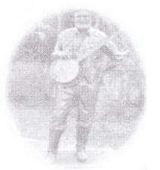
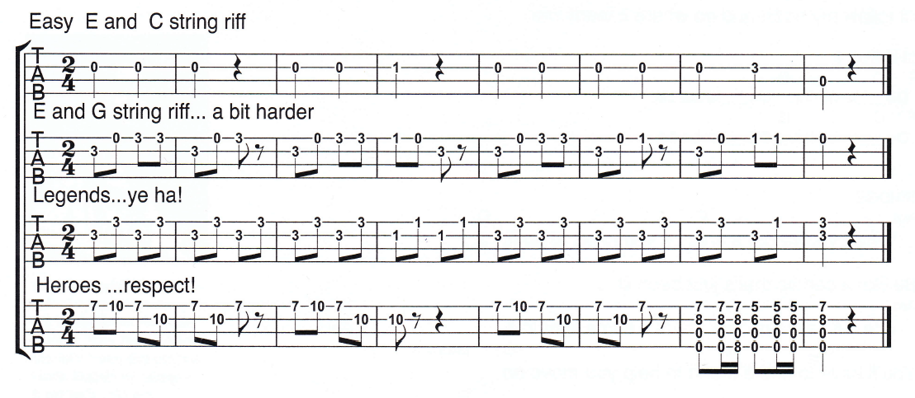

Slide 10
Easy

Slide 11
A Bit Harder

Slide 12
Legends

Slide 13
Heros

Slide 15
Arrangement
Introduction
Violin solo then 8 bars of instrumental
Verse 1
Verse 2
Chorus
Chorus
Instrumental
Instrumental
Verse 3
Verse 4
Chorus
Chorus
Instrumental
Chorus

